Slide 1



Collecting historical stock market data
From
Alpha Vantage
By- Priyanshu Goswami
Data Science Intern, HackVeda
Date: 28/11/2024

Slide 2
TABLE OF CONTENT:-
1. HOOK STORY.
2. THE OBJECTIVE.
3. API
4. GETTING START.
5. MAKE API CALL.
6. STEPS.
7. PROJECT GOAL.
8. SAVING DATA.
9. DEMONSTRATION.
10. CONCLUSION.
11. REFERENCE.

Slide 3

HOOK STORY:-
Title: Rohit Investment Journey
Meet Rohit, a passionate data enthusiast and a determined investor-in-the-making.
Rohit is on a mission to decode the complexities of the Indian stock market to make smarter investment decisions.
He strongly believes that diving deep into historical stock data holds the key to uncovering market trends and forecasting future movements with confidence.

Slide 4

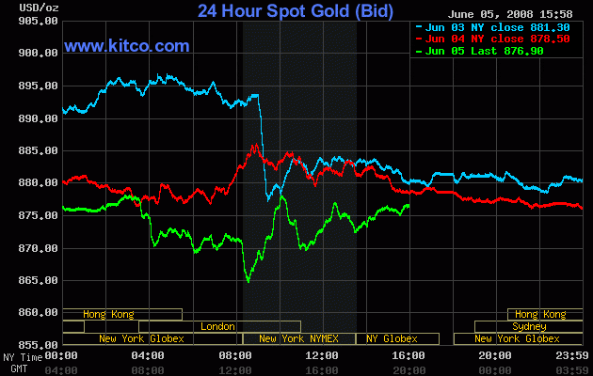
THE OBJECTIVE:-
Title: Task Overview :
Rohit Goal : Collect and preprocess historical stock market data
Deliverables:
1. A Python script for automated data collection.
2. Preprocessed and cleaned dataframes saved in CSV format.

Slide 5

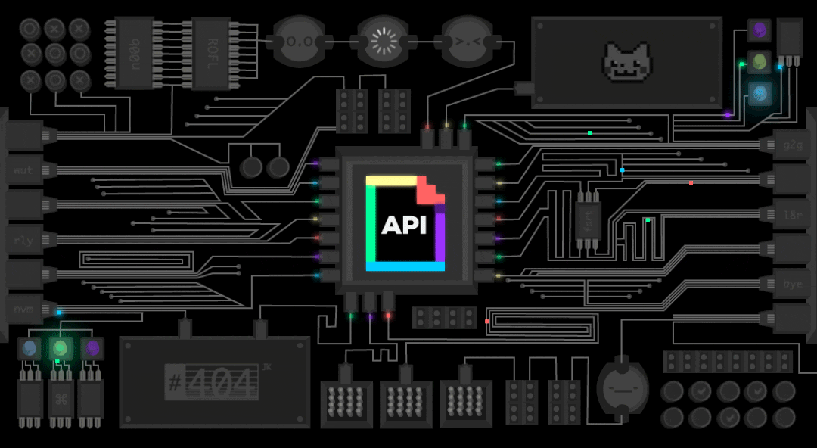

API:-
An API (Application Programming Interface) enables communication between different software applications.
It facilitates integration by allowing one application to use features or data from another.
APIs save development time by providing ready-to-use functionalities from other systems.
For instance, Raj leverages the Alpha Vantage API to retrieve stock market data for his project.

Slide 6

GETTING STARTED:-
Title: Acquiring an API Key Content:
Rohit requires reliable data for his project.
Solution: Utilize the Alpha Vantage API for accurate data.
Action Plan:
1. Raj registers for a free API key on the Alpha Vantage website.
2. The key will grant access to essential data for his application.

Slide 7

MAKING API CALLS:-
Title: Retrieving Stock Market Data with Alpha Vantage API:-
Steps to Follow:
1. Use the Alpha Vantage API to fetch stock market data.
2. Endpoints for accessing data for NSE and BSE indices are:
NSE Endpoint:
https://www.alphavantage.co/query?function=TIME_SERIES_DAILY_ADJUSTED&symbol=NSE&apikey=YOUR_API_KEY
BSE Endpoint: https://www.alphavantage.co/query?function=TIME_SERIES_DAILY_ADJUSTED&symbol=BSE&apikey=YOUR_API_KEY
3. Replace YOUR_API_KEY with your unique Alpha Vantage API key to access the data.

Slide 8

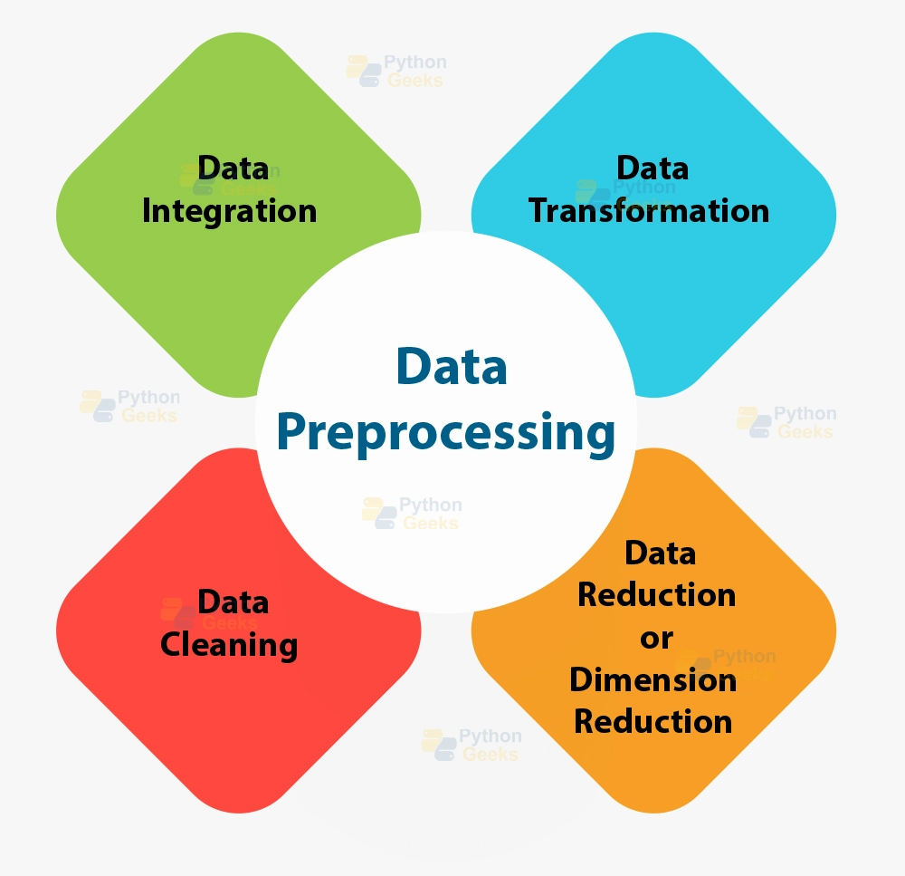
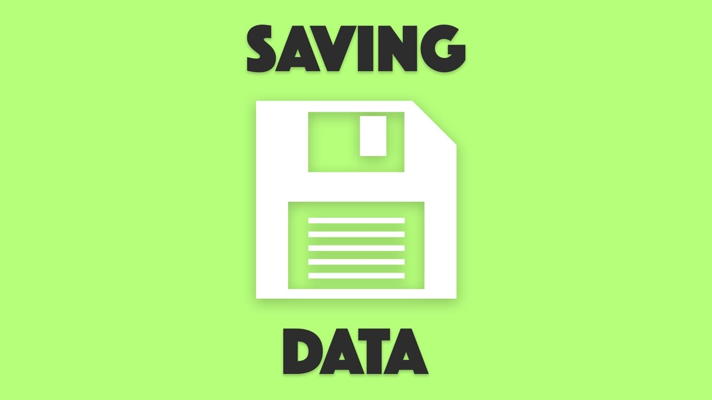
STPES:-
1.
2.
3.

Slide 9


PROJECT GOALS:-
1.DATA COLLECTION
Title:
Writing the python script content:
Rohit writes a python script using request and pandas.
Steps:
Import necessary libraries.
Define functions to call the API and retrieve data.
Store the data in pandas dataframes.
Title:
Cleaning the Data Content:-
Rohit ensures the data clean and ready for analysis.
He handles missing values:
Uses fill no. 0 to fill missing values.
Uses drop no. 0 to removes rows with missing data.
Rohit ensures data consistency and
Accuracy.
2.DATA PREPROCESSING

Slide 10
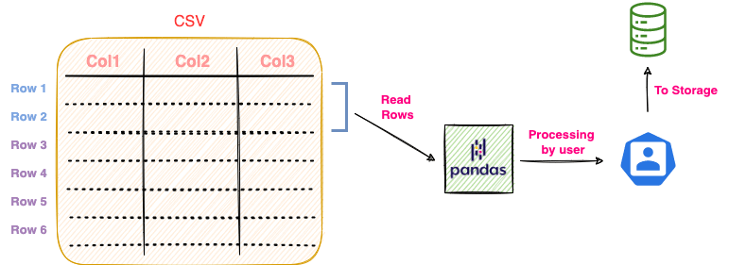
SAVING THE DATA:-
Title: Storing the Preprocessed Data Content:-
Rohit saves the cleaned dataframes as CSV.
Benefits:
Data is ready for analysis.
Can be shared and reused for further research.

Slide 11

CODE ANALYSIS & DEMONSTRATION:-

Slide 12
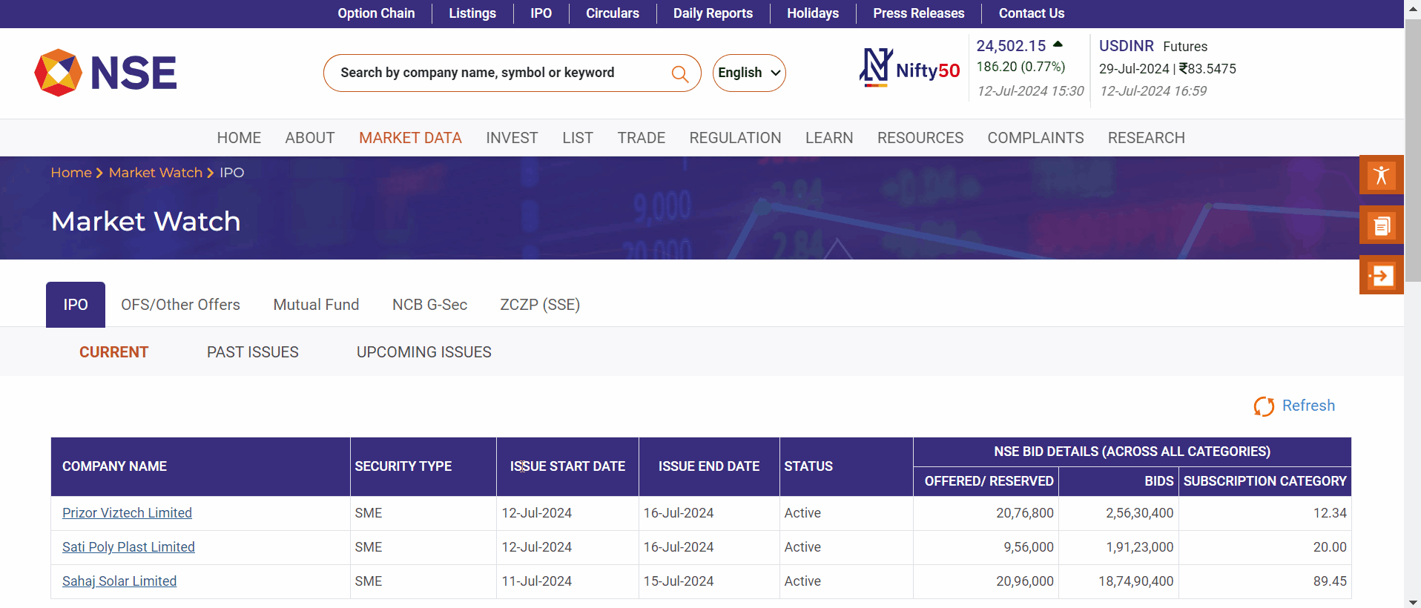
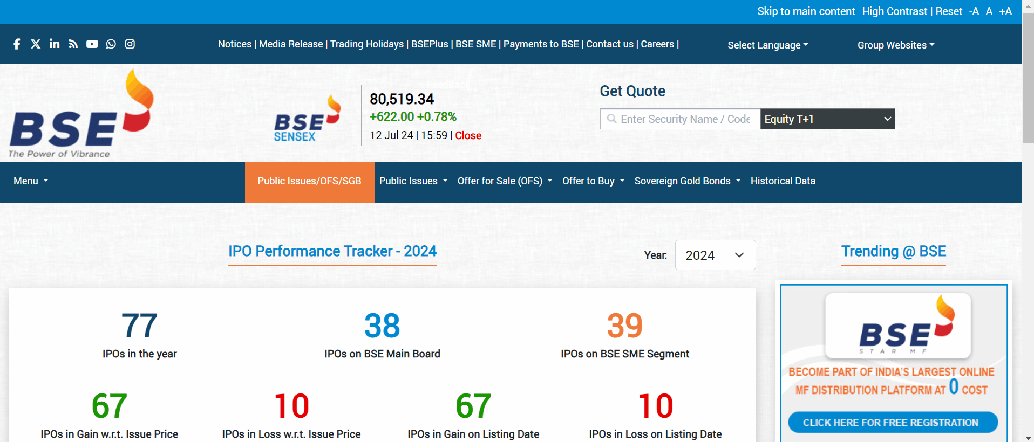
CONCLUSION:-
Rohit successfully collects and preprocesses the data for NSE and BSE.
He is now equipped with historical data to build predictive models.
This data will help Rohit make informed investment decisions

Slide 13

REFERENCES:-
1.
http://localhost:8888/notebooks/Collecting%20historical%20stock%20market%20data%20from%20Alpha%20Vantage.ipynb
2.
https://www.hackveda.in/intern-tracker/video-reference.php?g=Collecting%20historical%20stock%20market%20data%20from%20Alpha%20Vantage
3.
https://www.alphavantage.co/documentation/

Slide 14
THANK YOU
Q & A: goswamipriyanshu4290@gmail.com
: +91 6264664290

